Slide 1
Log Concept (Log4Net), Common Defect, And NUnit

Slide 2
Logging – Log4net
Section 1

Slide 3
Introduction
If you’ve been writing code for any reasonable amount of time, then it’s virtually impossible that you haven’t handled logging in any way, since it’s one of the most essential parts of modern, “real life” app development.
If you’re a .NET developer, then you’ve probably used some of the many famous logging frameworks available for use at this platform.
Log4net is a logging framework for the .NET platform. It’s definitely not the only one, but it’s one of the most popular frameworks out there.
A logging framework is a tool that can dramatically reduce the burden of dealing with logs.

Slide 4
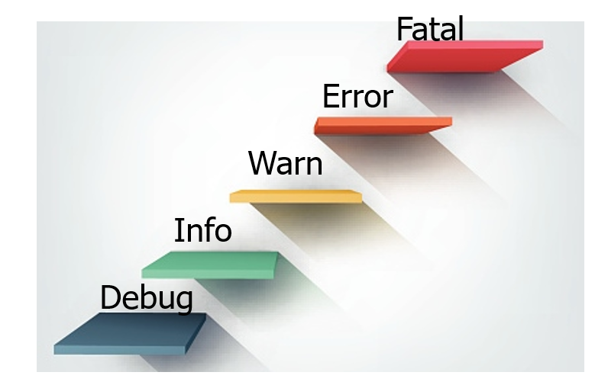
LOG levels
By assigning a log level to each message, you will be able to filter on level, notify on specific levels, etc.

Slide 5
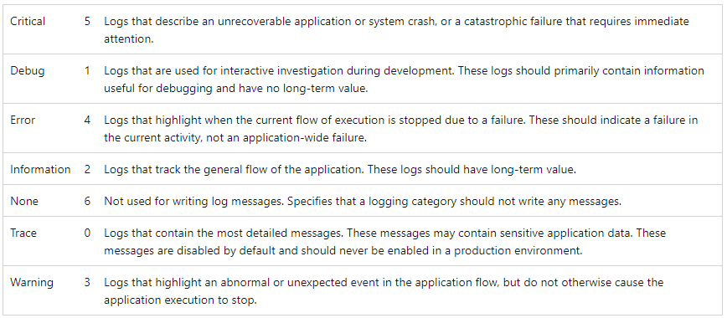
LOG Levels

Slide 6
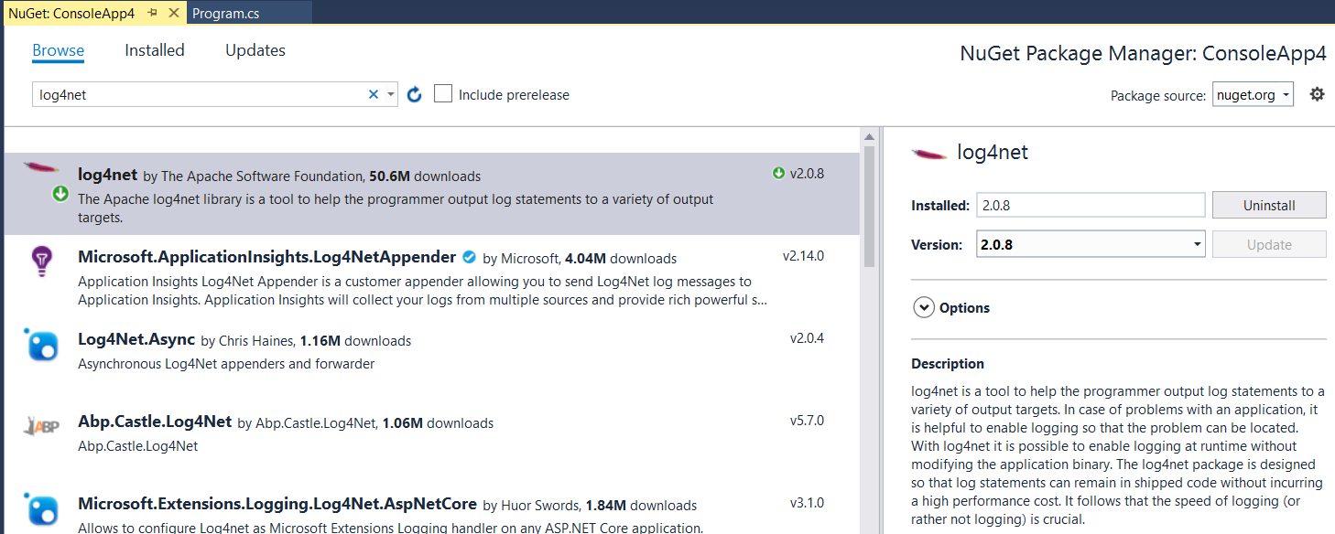
How to work with log4net

Slide 7
File App.config
<?xml version="1.0" encoding="utf-8" ?>
<configuration>
<configSections>
<section name="log4net" type="log4net.Config.Log4NetConfigurationSectionHandler,Log4net"/>
</configSections>
<log4net>
<appender name="TestAppender"
type="log4net.Appender.RollingFileAppender" >
<file value="D:\log\MyTestAppender.log" />
<encoding value="utf-8" />
<appendToFile value="true" />
<rollingStyle value="Date" />
<!--<rollingStyle value="Size" />
<maxSizeRollBackups value="5" />
<maximumFileSize value="5MB" />
<staticLogFileName value="true" />-->
<layout type="log4net.Layout.PatternLayout">
<conversionPattern value="%date %level [%thread] %type.%method - %message%n" />
</layout>
</appender>
<root>
<level value="All" />
<!-- If the following line is not included the log file
will not be created even if log4net is configured with this file. -->
<appender-ref ref="TestAppender" />
</root>
</log4net>
<startup>
<supportedRuntime version="v4.0" sku=".NETFramework,Version=v4.6.1" />
</startup>
</configuration>

Slide 8
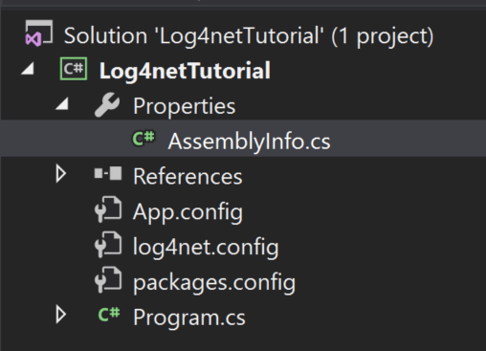
Tell log4net to Load Your Config
You can find it under the Properties section in your project:
In AssemblyInfo.cs file
// Let log4net know that it can look for configuration in the default application config file
[assembly: log4net.Config.XmlConfigurator(Watch = true)]

Slide 9
Logging messages
Messages are logged using a log4net class named ILog
To get an instance of the ILog class, use the LogManager
Now use the instance named log to log data to the configured targets
private static readonly log4net.ILog log =
log4net.LogManager.GetLogger System.Reflection.MethodBase.GetCurrentMethod().DeclaringType);
log.Debug("This is a Debug message"); log.Info("This is a Info message"); log.Warn("This is a Warning message"); log.Error("This is an Error message"); log.Fatal("This is a Fatal message");

Slide 10
Code
Log Something
using System;
class Program { static readonly log4net.ILog log = log4net.LogManager.GetLogger (System.Reflection.MethodBase.GetCurrentMethod().DeclaringType); static void Main(string[] args) { try { throw new Exception("This is test message..."); } catch(Exception ex) { log.Error(ex.Message); } Console.Read(); } }
After you execute the above program, a text file named MyTestAppender.log will be created and the exception message specified with be logged along with the timestamp

Slide 11
Common Defect
Section 2

Slide 12

Introduction
Every software developer deals with defects.
The really tough defects are the ones not detected by the compiler.
Nasty defects manifest themselves only when executed at runtime.
This topic is list of the top common defects

Slide 13
Hard code constants
Issue with giving a fixed value in codes, for example:
dgrView.PageSize = 10
strErr = "Error message here";
The problem occurs when you should change these values multiple times!!!
Preventive Action: define constants in the common constant module or in a configure files

Slide 14
The Dangling else Problem
Issue with below codes?
if (x == 0)
if (y == 0) error();
else {
z = x + y;
f (&z);
}
Confused on the else using!!!
Cause: else is always associated with the closest unmatched if.
Preventive: use appropriated braces ({)

Slide 15
Null Pointer Exception
Issue: the developer got Null-Pointer-Exception run-time error, while he/she did not detect that when compiling the codes
strReturn = objDoc.SelectNodes(strName);
Cause: the developer does not check null or think about null object before accessing object's value.
Preventive: Should check null before accessing object or pointer before using its member
If (objDoc != NULL)
strReturn = objDoc.SelectNodes(strName);

Slide 16
Code redundant
Code redundant issues:
Create new Object while we can reuse the object in previous command:
BeanXXX bean = new BeanXXX();
bean = objectYYY.getBeanXXX();
Variables are declared in based class but it is not used
Un-used methods/functions are existing in the application
Break a complex method/function to more simple methods / functions with only one or two lines of code, and could not be re-use
Preventive actions:
Should verify that the current design is possible and is the best by coding sample
Re-check unnecessary code to remove in coding review
Supervise and assign person to review code carefully before coding
Supervise strictly changing source code from team daily

Slide 17
Create objects in Loop
Issue with variables or create objects in Loop?
for (int i=0; i<dt.Rows.Count-1; i++){
String strName;
strName = dt.Rows[i]["Name"].ToString();
//do something here
}
Impact to the application performance!!!
Cause: memory is allocated repeatedly.
Preventive:
Variables should be declared before the loop statement or inside for() statement
Determine objects before loop statement

Slide 18
Errors with string
Issue Use string concatenated in loop:
string stNumber = "";
for(i=0; i<100; i++){
stNumber = stNumber + i;
}
Cause: Don’t understand class String in C#.
Preventive: Use StringBuilder instead

Slide 19
Check String empty
Issue : Using the operator “==”
if(stringVariable ==“”) {
// do smt here
}
Preventive :
// Correct answer:
if (string.IsNullOrEmpty(stringVariable)) {
//do something here
}

Slide 20
Memory waste
Issue: Memory saving errors adversely affect system performance
Preventive:
File operations: file read operations must be restricted to a minimum
Be economical when creating new objects

Slide 21
Errors by using Try/Catch
Do not use try ... catch nested
// Wrong
Try {
Try {
…
} catch() {
…
}
}catch () {
}
// Right
Try {
…
} catch () {
…
} catch() {
}

Slide 22
NUnit
Section 3

Slide 23
Lesson Objectives
Introduction to Nunit
Install and Configure
Write test
Run test
Report

Slide 24
NUnit
NUnit is a unit testing framework for .NET.
It is the most used framework for writing unit test cases.
We can write testing code in C#
NUnit is very easy to use.
Assert classes is used to test the conditions whether system under test (SUT) satisfy a condition or not.

Slide 25
Custom Attributes
TestFixture
Setup
TearDown
Test
Category
Ignore
TestCase
Repeat
MaxTime

Slide 26
Install and Configure
Step 0: Create Projects
Always creates separate project when creating project for NUnit.
Naming conventions test project name should be [Project Under Test].[Tests].
Use Class Library project template

Slide 27
Install and Configure
Practice: Create Projects
Create new solution
Create new project
Name: FA.Training
Template: Class Library
Edit Class1 to Student
Add new method inside Student class to get Average of 3 numbers:
public decimal Average(decimal a, decimal b, decimal c)
{
return (a + b + c) / 3;
}

Slide 28
Install and Configure
Practice: Create Projects (cont…)
Create new test project
Name: FA.Training.Test
Template: Class Library

Slide 29
Install and Configure
Step 1: Install NUnit
Install NUnit package from nugget test project
Install-Package NUnit -Version 3.12.0
Install NUnit3TestAdapter package from nugget to test project
Install-Package NUnit3TestAdapter -Version 3.14.0
Add reference from project test to project need to test
From FA.Training.Test, add reference to FA.Training to use all method from FA.Training

Slide 30
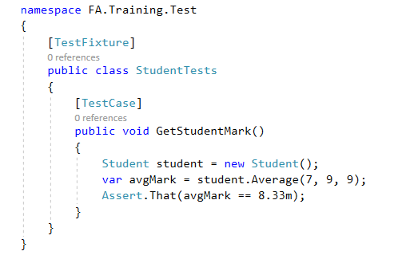
Write test case
Step 3: Write test case
In project FA.Training.Test, change Class1 to StudentTests
Add test method:

Slide 31
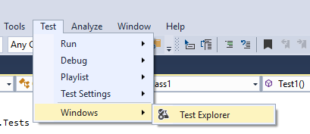
Run test case
Step 4: Run test case
Choose visual studio Test Menu -> Windows -> Test Explorer

Slide 32
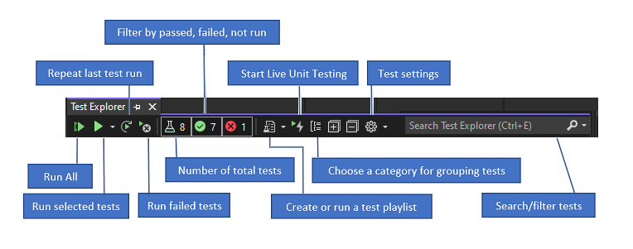
Run test case
Step 4: Run test case
Explorer test case then Run Selected Test

Slide 33
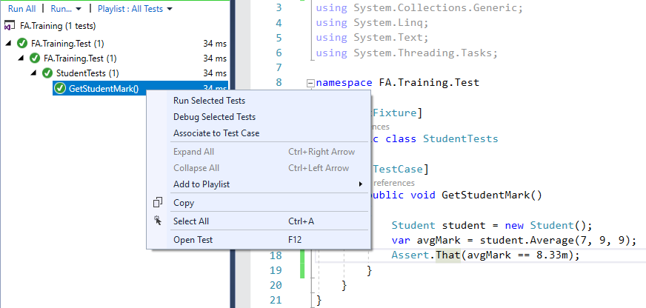

Slide 34
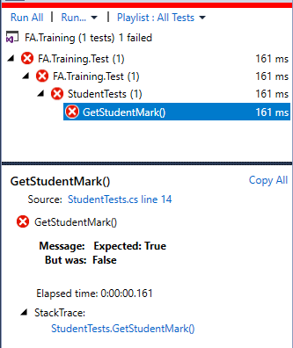
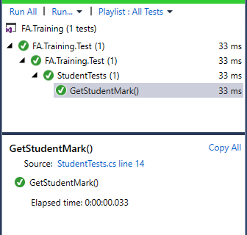
Check result
Resolve

Slide 35
Assert Class
Assert is NUnit framework class which has static methods to verify the expected behaviour.
If the Assert condition is passed then the NUnit test case is passed else failed.

Slide 36
Assert Methods
Assert.That
Assert.AreEqual/AreNotEqual
Assert.AreSame/AreNotSame
Assert.Equals
Assert.Contains
Assert.Greater/ GreaterOrEqual
….

Slide 37
TestCase Attribute
TestCase arguments: use same test case with different data.
ExpectedResult: specify different results for different parameters.
Author: specify author name in the test method who has written the test case
TestName: use different name than the specified test method name.

Slide 38
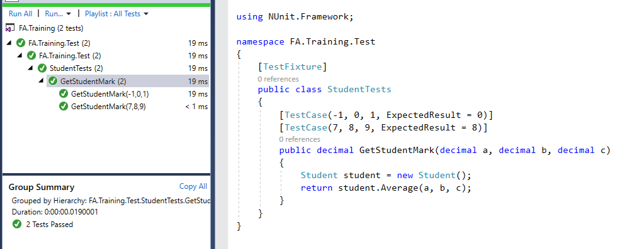

Slide 39
References
https://docs.microsoft.com/en-us/dotnet/csharp/programming-guide/inside-a-program/coding-conventions
https://www.dofactory.com/reference/csharp-coding-standards
https://docs.microsoft.com/en-us/visualstudio/test/walkthrough-creating-and-running-unit-tests-for-managed-code?view=vs-2019

Slide 40

Thank you

